Slide 1
Microsoft Dynamics AX 2012 Administration Workshop Chapter 1: Overview and Planning
Presenter Name
Presenter Title
Presenter Company

Slide 2
Conditions and Terms of Use
Microsoft Confidential
This training package is proprietary and confidential, and is intended only for uses described in the training materials. Content and software is provided to you under a Non-Disclosure Agreement and cannot be distributed. Copying or disclosing all or any portion of the content and/or software included in such packages is strictly prohibited.
The contents of this package are for informational and training purposes only and are provided "as is" without warranty of any kind, whether express or implied, including but not limited to the implied warranties of merchantability, fitness for a particular purpose, and non-infringement.
Training package content, including URLs and other Internet Web site references, is subject to change without notice. Because Microsoft must respond to changing market conditions, the content should not be interpreted to be a commitment on the part of Microsoft, and Microsoft cannot guarantee the accuracy of any information presented after the date of publication. Unless otherwise noted, the companies, organizations, products, domain names, e-mail addresses, logos, people, places, and events depicted herein are fictitious, and no association with any real company, organization, product, domain name, e-mail address, logo, person, place, or event is intended or should be inferred.
Copyright and Trademarks
© 2012 Microsoft Corporation. All rights reserved.
Microsoft may have patents, patent applications, trademarks, copyrights, or other intellectual property rights covering subject matter in this document. Except as expressly provided in written license agreement from Microsoft, the furnishing of this document does not give you any license to these patents, trademarks, copyrights, or other intellectual property.
Complying with all applicable copyright laws is the responsibility of the user. Without limiting the rights under copyright, no part of this document may be reproduced, stored in or introduced into a retrieval system, or transmitted in any form or by any means (electronic, mechanical, photocopying, recording, or otherwise), or for any purpose, without the express written permission of Microsoft Corporation.
For more information, see Use of Microsoft Copyrighted Content at http://www.microsoft.com/about/legal/permissions/
Microsoft®, Active Directory®, ActiveX®, BizTalk®, Internet Explorer®, Microsoft Dynamics®, SharePoint®, SQL Server®, Visual Studio®, Lync®, and Windows® are either registered trademarks or trademarks of Microsoft Corporation in the United States and/or other countries. Other Microsoft products mentioned herein may be either registered trademarks or trademarks of Microsoft Corporation in the United States and/or other countries. All other trademarks are property of their respective owners.

Slide 3
Students: How to View this Presentation
Switch to Notes Page view
Click View on the ribbon and select Notes Page
Use page up or page down to navigate
Zoom in or out as needed
Most slides will have supporting text that you can view now or after the delivery
Add notes to your copy of the presentation if you want to
You take the presentation files home with you

Slide 4
Overview
Overview
This chapter will give you an overview of:
System Architecture
Development System and Tools
Planning a Deployment: Hardware and Software
Disaster Recovery

Slide 5
Objectives
After completing this chapter, you will be able to:
Understand system architecture
Navigate the development system
Discuss steps for planning a deployment
Discuss hardware and software requirements
Describe disaster recovery considerations

Slide 6
Introduction
Microsoft Dynamics AX Overview and Architecture:
System Architecture
Development System and Tools
Planning a Deployment: Hardware and Software
Disaster Recovery

Slide 7
System Architecture
Single database
Three-tier application architecture
Client
Application Server
Data
Layered application code
Integrated development environment
Visual Studio integration

Slide 8

System Architecture (continued)
Client/Remote Desktop
External Applications
Integration Client
Web Browser
Microsoft Dynamics AX Client
HTTP/HTTPS
Web Server/Reporting/Integration
SSRS
Integration Hosts
Internet Information Services (IIS)
RPC & WCF
SSAS
File System
MSMQ
WCF
.NET BC
WCF
RPC
Application Object Server (Online and Batch)
AOS Functions
AOS Services
.NET Framework 4
Workflow
WCF
ODBC (SNAC)
ODBC (SNAC)
SQL Server
Microsoft Dynamics AX Business DB
Microsoft Dynamics AX Model DB
SharePoint DB
SSRS
SSAS

Slide 9
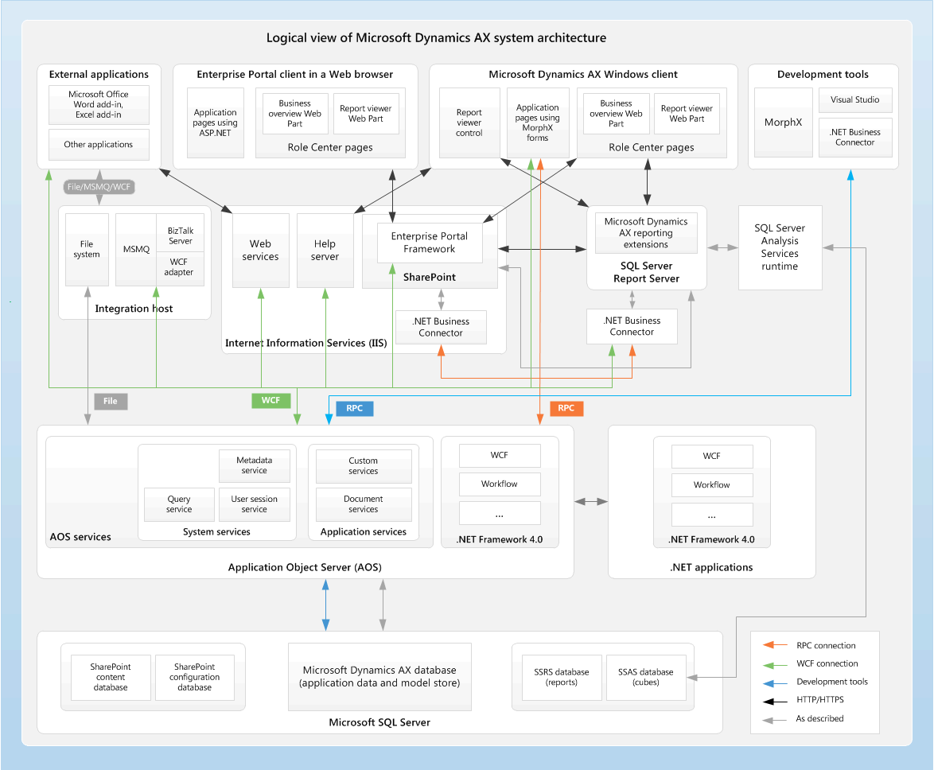
System Architecture (continued)
Notes:
If you understand the internal architecture of Microsoft Dynamics AX, you can more effectively make decisions when you plan, customize, and deploy a system.
The diagram above provides a high-level overview of the system architecture of Microsoft Dynamics AX.

Slide 10
Component Communication Types
RPC = Remote Procedure Call
WCF = Windows Communication Foundation
MSMQ = Microsoft Message Queue
Source Component | Connection Type | Destination Component
Microsoft Dynamics AX client | RPC and WCF (services) | AOS
Enterprise Portal | RPC and WCF (services) | AOS
IIS (web services) | WCF (services) | AOS
IIS (Help server) | WCF (services) | AOS
Office Add-ins (Word, Excel) | WCF (services) | AOS
Report Server | WCF (services) | AOS
Analysis Server | Direct database connection (read-only) | Microsoft Dynamics AX database
BizTalk Server | WCF (services), flat files, MSMQ | AOS

Slide 11
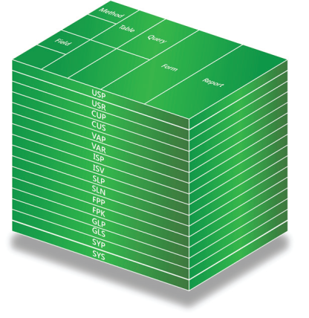
AX Application Architecture - Layers
Why do we use them?
What are they?
USR/USP
CUS/CUP
VAR/VAP
ISV/ISP
SLN/SLP
FPK/FPP
GLS/GLP
SYS/SYP
Notes:
Layers
Microsoft Dynamics AX uses a layering system where layers are a hierarchy of levels in the application source code. This ensures that modifications and additions can be made without interfering with the application objects on other levels.

Slide 12
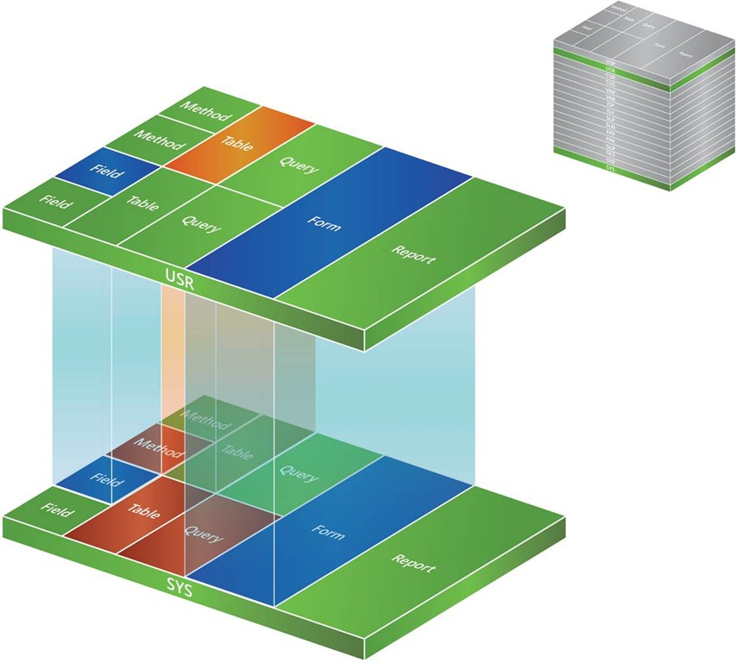
Layers

Slide 13
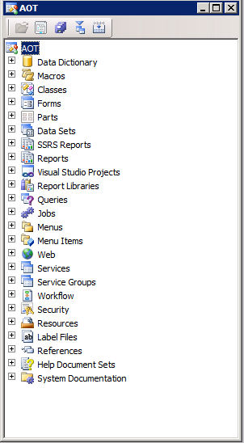
Development System
IntelliMorph and Usage data
MorphX
X++
AOT
Notes:
In this section, we provide an overview of the development system and tools in Microsoft Dynamics AX.
MorphX
The integrated development environment (IDE) in Microsoft Dynamics AX is called MorphX. It includes tools for designing, editing, compiling, and debugging code in Microsoft Dynamics AX.
AOT
The programmable objects in Microsoft Dynamics AX—tables, forms, reports, classes, and so on—are organized in a tree structure called the Application Object Tree (AOT). Creating and editing objects is enhanced by drag-and-drop functionality, and by automatic settings for certain object properties. The screenshot above shows the AOT.
For a list of all the elements in the AOT, visit: http://msdn.microsoft.com/en-us/library/aa843974.aspx.
X++
X++ is the programming language in Microsoft Dynamics AX. X++ uses object-oriented programming principles, such as encapsulation, inheritance, classes, objects, methods, and properties.
The X++ syntax will be familiar to C# developers, and incorporates SQL data manipulation statements.

Slide 14
Customizing Microsoft Dynamics AX
MorphX
X++
User-focused (look-and-feel) customizations
Drag-and-drop UI changes
Usage data &
IntelliMorph
Developer access required (AOT)
System-wide changes
Some drag and drop
Developer access required (AOT)
System-wide changes
Change business logic
Code required

Slide 15
Usage Data and IntelliMorph
Usage data
Last values used for forms and reports
Individual customizations to forms
Settings stored, per user, in a SQL Server table (SysLastValue)
IntelliMorph
Controls how the User Interface (UI) is displayed
Used to modify UI elements (forms, reports, menus)
Drag and drop
No code

Slide 16
Using Usage Data and IntelliMorph
Customize a form
Right-click on a form and select Personalize
Usage Data
From the main menu select Tools > Options

Slide 17
MorphX
Integrated Development Environment (IDE):
Design
Edit
Compile
Debug
Develop and customize Windows and web interfaces
Common tasks that use drag and drop functionality:
Forms
Menus
Reports
Customizations are stored in layers
Notes:
The MorphX Development Suite is the integrated development environment (IDE) used to develop and customize both the Windows interface and the Web interface.
An IDE integrates development functions such as designing, editing, compiling, and debugging within a common environment.
With MorphX, common operations such as building or modifying forms, menus, and reports are done using drag-and-drop functionality with little or no coding. The AOT is part of the MorphX system.

Slide 18
X++
X++ is the object-oriented programming language for Microsoft Dynamics AX
The X++ license:
Gives access to all classes in Microsoft Dynamics AX and a development code for the customer layer.
Allows customers to put modified objects in the CUS layer and the USR layer.
Notes:
X++ is the object-oriented programming language that is used in the MorphX environment and is what Microsoft Dynamics AX is built on.
The X++ license gives access to all classes in Microsoft Dynamics AX and a development code for the customer layer. It enables customers to put modified objects in the CUS layer, the USR layer, or both.
The X++ license modifies standard routines, such as the invoice routine or the posting process for a ledger journal. It can also be used to create new business logic if functionality needs to be added to the application.

Slide 19
Development Tools
MorphX development tools are available from the Tools menu
Many tools are also available from the Add-ins shortcut menu in the Application Object Tree (AOT)
When tools are activated from the Add-ins menu, they use the current AOT node as the point of departure
Notes:
MorphX development tools are available on the Tools menu. Many tools are also available from the Add-ins shortcut menu in the Application Object Tree (AOT). When tools are activated from the Add-ins menu, they take the current AOT node as the point of departure.
For a list of some of the development tools available in the Development Tools and Add-ins menus, visit:

Slide 20
Development Workspace
Provides tools to create and edit application elements, such as forms, tables, and X++ classes
You can open multiple workspaces on the same client where application elements are always synchronized
Notes:
The Development Workspace in Microsoft Dynamics AX 2012 provides tools to create and edit application elements, such as forms, tables, and X++ classes.
By default, Microsoft Dynamics AX opens in the Application Workspace, which displays user interface (UI) elements for end users.
By using two or more display monitors, you can open multiple workspaces on the same client where application elements are always synchronized.

Slide 21
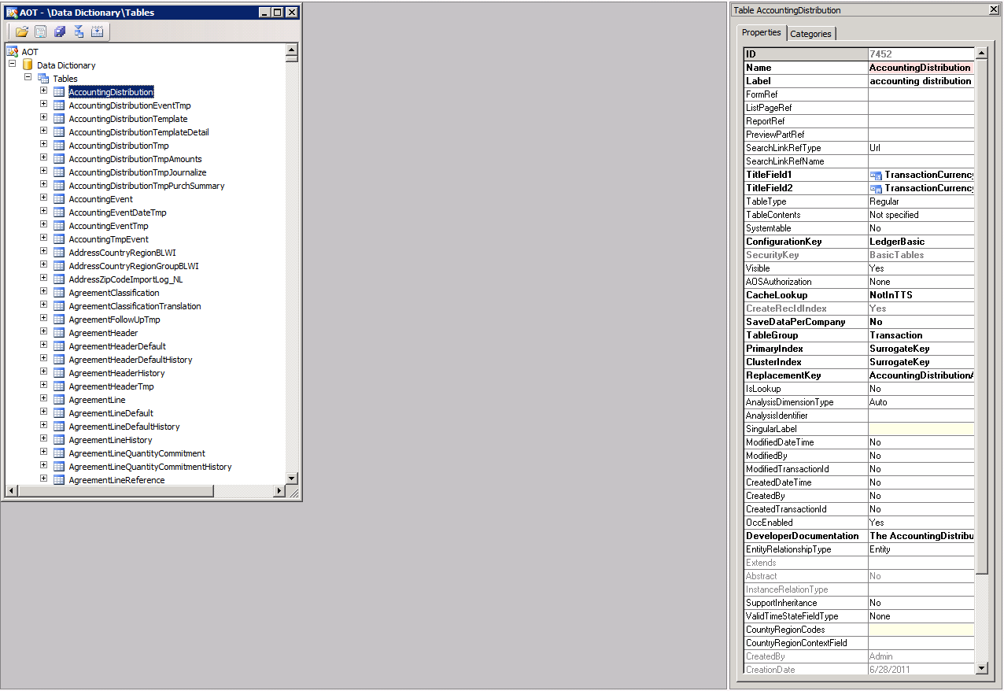
Development Workspace (continued)
Notes:
The screenshot above shows the Development Workspace.

Slide 22
Development with Visual Studio
Managed-code support
Report development
Enterprise Portal development
Integration between MorphX and Visual Studio—leverage the benefits of each and work in the environment that best suits the scenario
Notes:
The Microsoft Dynamics AX development environment, MorphX, and the Visual Studio development environment are integrated through Visual Studio Tools for Microsoft Dynamics AX.
Visual Studio Tools for Microsoft Dynamics AX is a collection of tools that enable managed code development for Microsoft Dynamics AX. These tools provide developers with a rapid application development (RAD) experience in the Visual Studio IDE.
The Visual Studio Tools for Microsoft Dynamics AX include:
Managed code support
Developers can use type-safe proxies to call X++ classes from managed code
Report development
Enterprise Portal development
Close integration between MorphX and Visual Studio means that developers can leverage the benefits of each development tool and work in the environment that best suits their development scenario
The screenshot on the previous slide shows the Microsoft Dynamics AX 2012 environment in Visual Studio.

Slide 23
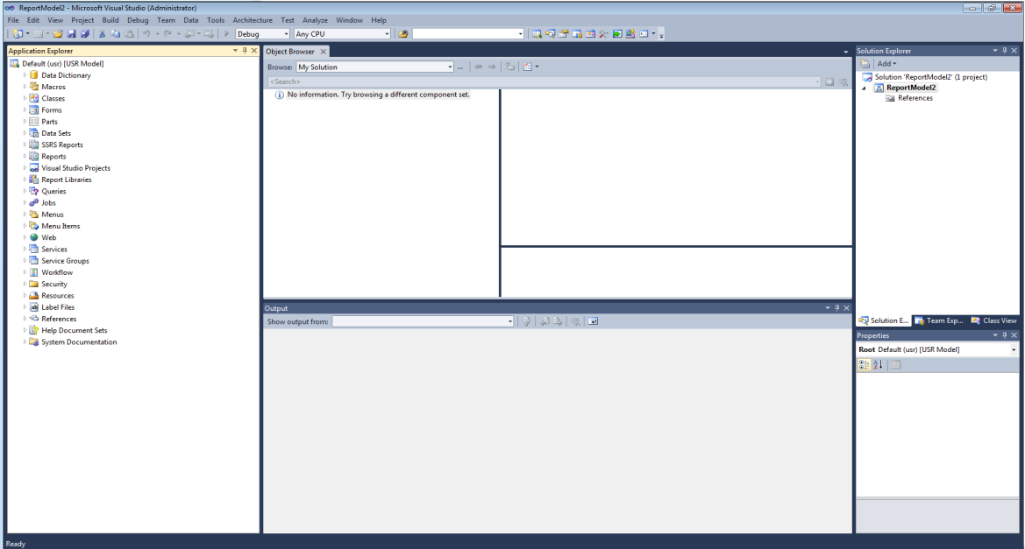
Development with Visual Studio (continued)
Notes:
The screenshot above shows the Microsoft Dynamics AX 2012 environment in Visual Studio.

Slide 24
Database Components
Most tables are accessed from the Data Dictionary node in the AOT
System tables are accessed from the System Documentation node in the AOT
Notes:
Microsoft Dynamics AX relies on a single SQL Server database. During upgrade, an additional database, the baseline model store, is used.
The Microsoft Dynamics AX database contains two primary types of tables:
Tables that can be accessed from the data dictionary in the Application Object Tree (AOT)
Tables that can be accessed from the System Documentation section of the AOT: kernel tables and model store tables
Tables that can be accessed from the data dictionary
The tables that can be accessed from the data dictionary in the AOT include tables in the following table groups:
Framework – Includes tables that are used by underlying Microsoft Dynamics AX frameworks, such as Application Integration Framework (AIF). These tables are created during installation and are not associated with configuration keys.
Group – Includes tables that are used to categorize the tables in the Main table group.
Main – Includes the principal or master tables that contain data for central business objects. These tables typically hold static, base information.
Miscellaneous – Includes tables that have not been otherwise categorized. This table group is the default group for new tables.
Parameter – Includes tables that contain parameters or setup information for tables in the Main table group.
Reference – Includes tables that contain reference data.

Slide 25
Notes:
Database Components (continued)
Transaction, Transaction header, and Transaction line – Include tables that contain transaction data. The tables in the Transaction header table group categorize the tables in the Transaction line table group. There is a one-to-many relationship between a Transaction header table and a Transaction line table.
Worksheet, Worksheet header, and Worksheet line – Include tables that contain information that is validated and made into transactions. Unlike the data that is contained in tables in the Transaction table groups, data in the Worksheet table groups is temporary. After data from these tables has been made into transactions, and moved into transaction tables, the Worksheet tables become obsolete and can be deleted without affecting system stability.
Tables that can be accessed from the System Documentation section of the AOT
Kernel tables and model store tables are visible in the AOT, in the System Documentation > Tables section. These tables cannot be directly imported, exported, or changed.
Kernel tables are used by Microsoft Dynamics AX. These tables are not associated with table groups.
The model store is the part of the Microsoft Dynamics AX database, where all application elements for Microsoft Dynamics AX are stored. Customizations are also stored in the model store. The model store replaces the Application Object Data (AOD) files that were used in earlier versions of Microsoft Dynamics AX.
The model store can be managed by using the AXUtil command-line utility or Windows PowerShell. In Microsoft Dynamics AX, the model store tables are visible in the AOT, in the System Documentation > Tables > SysModel* section.

Slide 26
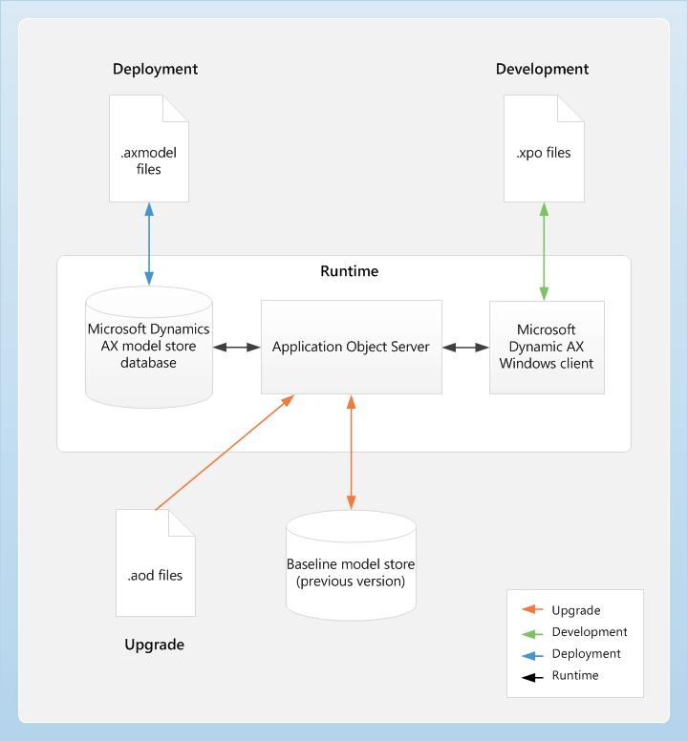
Model Store Architecture
Models and model files
Model store
Baseline model store
Notes:
Models and Model Files
The model store is the portion of the Microsoft Dynamics AX database where all Microsoft Dynamics AX application elements are stored, including customizations.
The model store replaces the AOD files used in previous releases of Microsoft Dynamics AX.
Layer and model information are integral parts of the store. The Application Object Server (AOS) has access to the model store, handles layer-flattening, and provides model data to all the Microsoft Dynamics AX sub-systems, such as form- and report-rendering and X++ code.
Microsoft Dynamics AX contains sixteen layers. Each layer consists of one or more logical parts, called models.
A system-generated model exists for each layer. For example, the VAR Model is the system-generated model for the VAR layer. System-generated models allow you to install and start working with the base Microsoft Dynamics AX system.
A model is a logical grouping of elements in a layer. An element can exist in exactly one model in a layer. Examples of elements are a table or class. The same element can exist in a customized version in a model in a higher layer.
Models are identified by a name and a publisher, and have a set of properties that can be modified, including a version number.

Slide 27
Notes Continued
Notes:
Model Store Architecture (continued)
Model Store
The model store in Microsoft Dynamics AX 2012 is used in the following ways:
Installation – During the installation, the Setup program uses axutillib.dll to import the .axmodel files from the installation path to the model store.
Upgrade – During an upgrade, the application (AOD) files from the earlier version are imported into the Microsoft Dynamics AX 2012 model store and into the old model store.
The model store contains the new model, and the old model store contains the old model.
The old model store mimics the old folder where the earlier version of Microsoft Dynamics AX stored the application files that were replaced.
Development environment – In the development environment, developers can continue to use the .xpo files to export and import code. The .axmodel is the preferred deployment artifact. Use the .axmodel files to migrate application elements from one environment to another, such as from the development environment to the test environment. Export models to the .axmodel files from the source system and import the .axmodel file to the target system.
Runtime – At runtime, the AOS retrieves the application elements, such as forms, reports, and classes, from the model store to respond to client requests.
Baseline Model Store
The baseline model store holds model store tables for the earlier version of the metadata and is used only during upgrade.
The baseline model store is an inactive model store, which allows a developer to compare previous code lines to the current, active code line.
The baseline model store is similar to the old folder in earlier versions of Microsoft Dynamics AX.

Slide 28
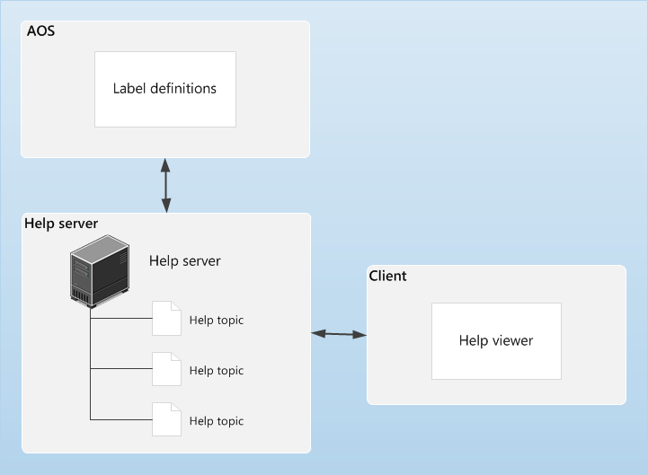
Help System Architecture
Notes:
You can use the Help system to supply Help documentation for the application and development workspaces. You can add new help content by adding correctly formatted HTML files to the Help server.
No compilation, rebuilding, or AOT deployments are necessary to add help documentation. The figure above illustrates the architecture of the Microsoft Dynamics AX Help system.
How it Works
Consider the following example.
An employee clicks the Help menu, or presses F1, when viewing a form in Microsoft Dynamics AX.
The Microsoft Dynamics AX client determines which help topic should be displayed. It requests that specific topic from the Help server.
The Help server locates the help topic and determines if there are any labels to define for that topic. If so, the Help server requests the definitions of the labels from the Microsoft Dynamics AX Application Object Server (AOS).
For example, if a help topic contains the label @SYS11904, the Help sever will request the definition of this label from the AOS. Once the AOS returns the definition, Customer group, the Help server replaces all instances of @SYS11904 with Customer group.
The Help server sends the help topic to the client, where it is displayed in the Help viewer.

Slide 29
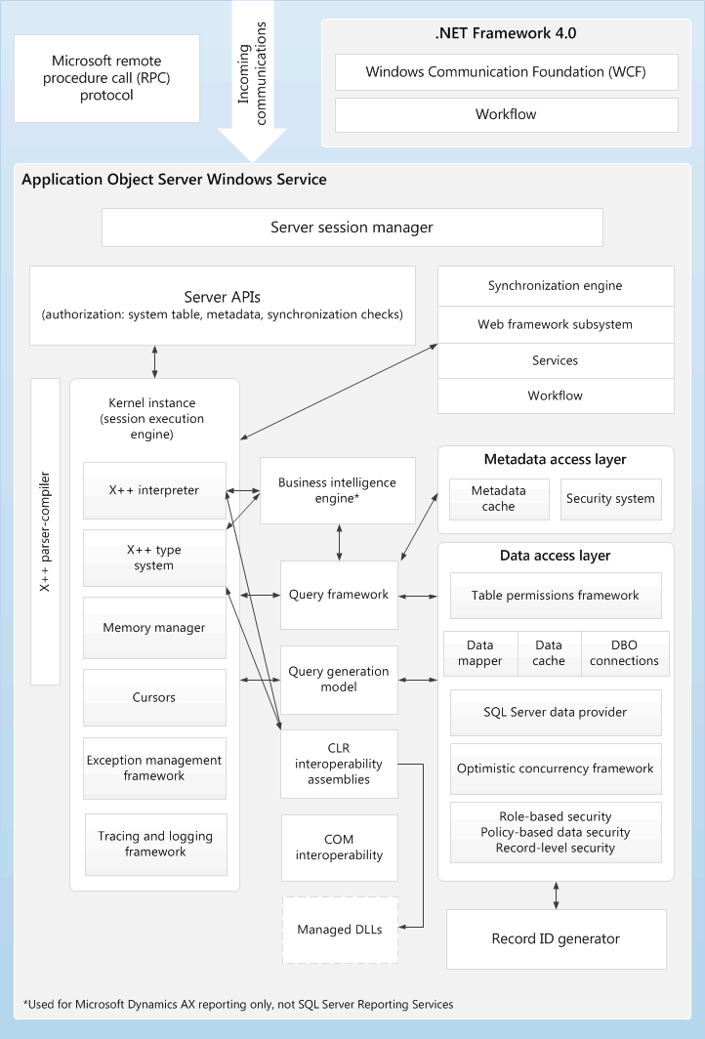
AOS Architecture
Notes:
An Application Object Server (AOS) is a core component of the Microsoft Dynamics AX installation and is installed by using Setup.
An AOS enforces security, manages connections between clients and the database, and provides the foundation where business logic for Microsoft Dynamics AX is executed.
An AOS is implemented as a Windows service. By default, an AOS is listed in the Services pane as Microsoft Dynamics AX Object Server 6.0$ InstanceName. As a Windows service, AOS works in the following ways:
An AOS runs in the security context of either a specific domain account or the NT Authority/Network Service account, depending on the setup.
The status of an AOS is reported to the Windows event logs. Therefore, administrators can view errors and warnings that help them troubleshoot problems.
You can install an AOS on a single computer, together with the database, model store, and other Microsoft Dynamics AX components.
Alternatively, you can install an AOS on multiple computers and group the computers in a load-balanced cluster.
Clients communicate with an AOS by using remote procedure calls (RPCs), Windows Communication Foundation (WCF), or AOS services.

Slide 30
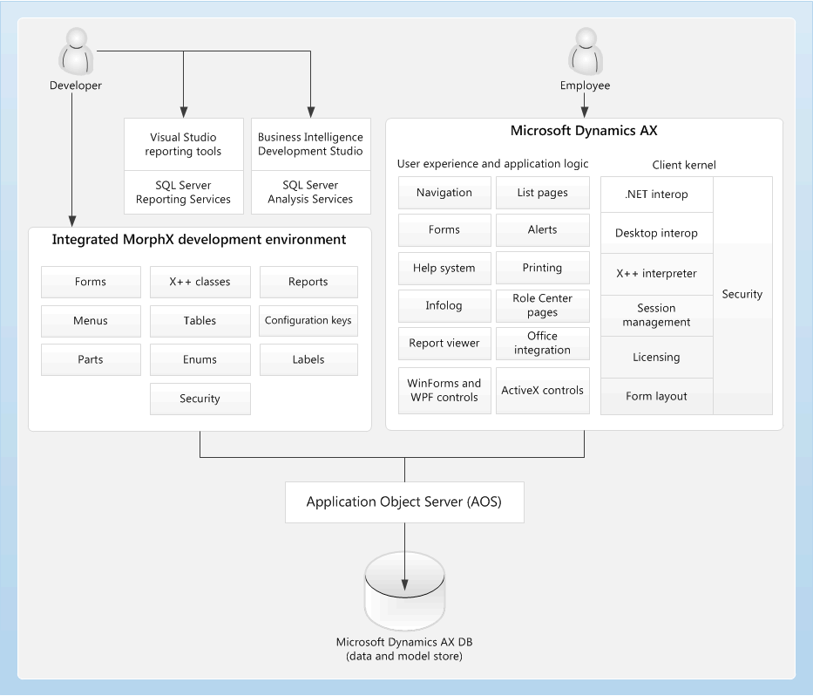
Client Architecture
Notes:
The client application is a 32-bit Windows application that provides a rich UI for the Microsoft Dynamics AX application.
The client is typically used by employees in the organization.
External users, and users who do not require the rich UI that the client application offers, can use Enterprise Portal for Microsoft Dynamics AX. Enterprise Portal provides access to the Microsoft Dynamics AX application from a web browser.
The client application provides the following functionality:
Rich UI – The client application that consists of forms, menus, and controls.
The MorphX development environment – The development environment is integrated into the client application.
Integration with Microsoft Office – The Microsoft Dynamics AX application can be integrated with Microsoft Office.
Unified communications – The client provides integrated, unified communications by using Lync.
Integration with the Telephony Application Programming Interface (TAPI) – The client supports TAPI, which is a standard Windows interface that integrates telephone systems and Windows-based software.
Reports – The Microsoft Dynamics AX application provides reports that are based on SQL Server Reporting Services (SSRS).

Slide 31
Notes Continued
Notes:
Client Architecture (continued)
The client communicates with various Microsoft Dynamics AX components in the following ways:
The client uses the remote procedure call (RPC) protocol to communicate with Application Object Server (AOS). The client never accesses the database or metadata directly. AOS sends the application objects and data to the client.
The data layer that the client uses is based on data sources that are specified in metadata for forms and queries.
The client uses a report Web Part to interact with the report server. By calling the web services that are exposed by the report server, the report control in the Web Part displays information that is contained in Reporting Services reports.
The client provides workflow forms, alerts, and controls so that users can participate in the business process by using the Workflow system. The Workflow system is a Microsoft Dynamics AX component that enables workflow processes by using Windows Communication Foundation (WCF) classes.
The client provides a Help viewer, which is an application that displays context-sensitive help topics. The help topics are retrieved from a Help server that is located on-premises.
The client also provides Role Centers, or role-based home pages, for users. Role Centers provide role-specific tasks, activities, alerts, reports, and business intelligence that help users increase their productivity.

Slide 32
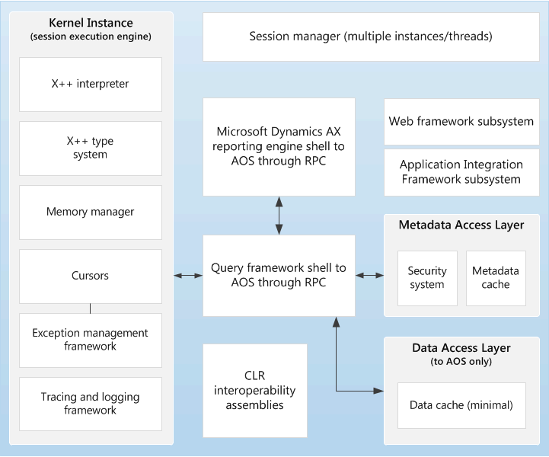
.NET Business Connector
Notes:
The .NET Business Connector is a component of the development environment for Microsoft Dynamics AX. You can use the .NET Business Connector to build software applications that can be integrated with Microsoft Dynamics AX, and consider it a Microsoft Dynamics AX client that does not have a UI. You can use the .NET Business Connector to access the same X++ code, business logic, and security model that are available to the Microsoft Dynamics AX client. The .NET Business Connector contains a kernel that interprets and executes code, and provides a run-time environment for interacting with elements in the Application Object Tree (AOT).
During execution, applications that are created by using.NET Framework are managed by the common language runtime (CLR). These applications are called “managed applications.” The .NET Business Connector enables managed applications to interact with instances of an Application Object Server (AOS) by providing a set of .NET managed classes. These .NET managed classes, in turn, enable access to X++ classes in Microsoft Dynamics AX.
By default, the .NET Business Connector is installed with the Application Integration Framework (AIF). However, the .NET Business Connector can also be installed as a stand-alone component and is used to develop third-party applications that can be integrated with Microsoft Dynamics AX.

Slide 33
Plan System Topology
Important questions to ask:
Which features and functionality do I need?
Are users spread out across multiple locations?
What hardware do we have?
What are our current needs and future growth plans?
Notes:
Important: The Microsoft Dynamics AX 2012 Implementation Guide discusses areas the organization might have to address depending on the deployment requirements.
In addition to the standard system requirements presented in this course, the Implementation Guide contains many additional tasks to consider depending on the system configuration. Microsoft also has a website that contains the latest requirements and other information about Microsoft Dynamics AX 2012. Refer to PartnerSource for more information.

Slide 34
Steps in System Planning
Define and document the following items:
Number of transactions
Number of users
Uses of system (modules and features to be implemented)
Required external user access
Required web access
Required availability
Projected growth rate
Number of sites
Applications to integrate

Slide 35
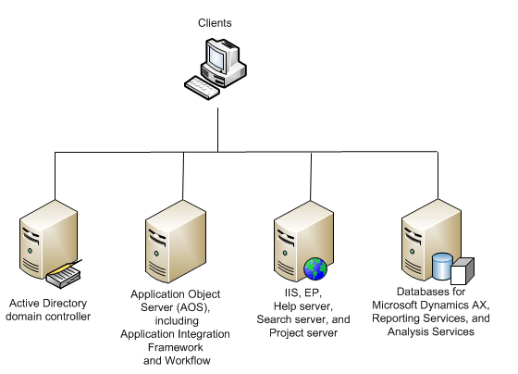
Small-Scale Deployment
Just the basics
Not highly available
Not scalable
Users not distributed

Slide 36
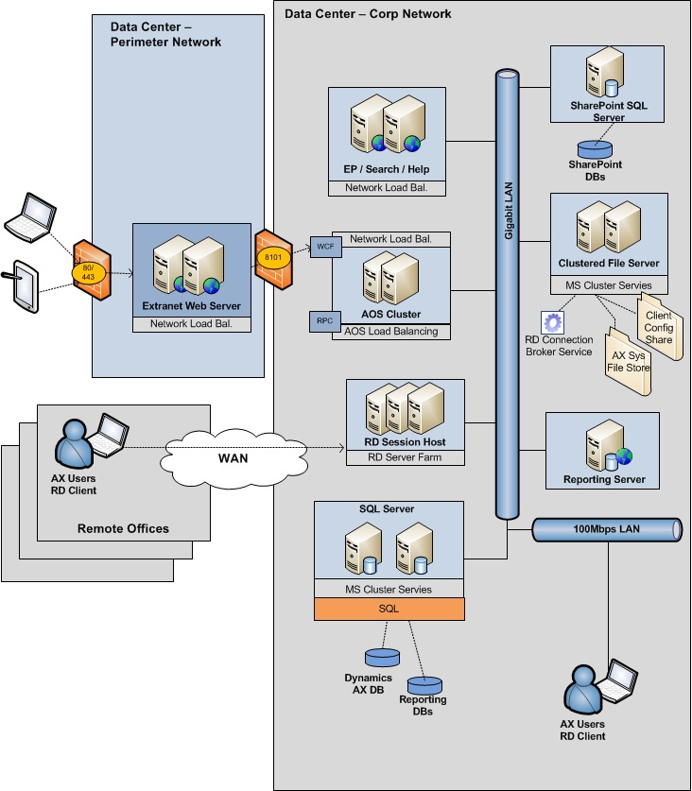
Medium- and Large-Scale Deployment Sample
More complex
High Availability for some components
Infrastructure more distributed for scalability
Multiple locations and client types
More network and security considerations

Slide 37
Server Components
Application Object Server (required component)
Database with Models (required component)
Enterprise Portal/Enterprise Search
Reporting and Analysis extensions
AIF/Services
.NET Business Connector
Help server
Notes:
Application Object Server (AOS)
You can deploy the AOS on a single computer or create a load-balanced cluster of multiple AOS’s.
The AOS uses many libraries from .NET Framework 4, such as the Windows Communication Foundation (WCF) and Windows Workflow Foundation (WF).
Enterprise Portal (EP)
Internal users (employees) and external users (vendors, customers, business partners) can use the Enterprise Portal to access data and functionality through a highly customizable, role-based web portal.
You can also create Internet facing public sites with limited functionality for anonymous users.
Enterprise Portal requires ASP.NET, Microsoft SharePoint Foundation 2010 or Microsoft SharePoint Server 2010, and Internet Information Services (IIS).
Reporting
SQL Server Reporting Services (SSRS) is a solution for users to create and view traditional, paper-based reports, and interactive, web-based reports.
To integrate Microsoft Dynamics AX and Reporting Services, install the reporting extensions on a server running Reporting Services.

Slide 38
Notes Continued
Notes:
Server Components (continued)
Analytics
SQL Server Analysis Services (SSAS) is a server-based solution that provides online analytical processing (OLAP) functionality.
To integrate Microsoft Dynamics AX and Analysis Services, install the analysis extensions on a server running Analysis Services. When you install the analysis extensions, a default OLAP database and cubes are deployed to Analysis Services.
Workflow
Microsoft Dynamics AX uses the Windows Workflow Foundation (WF) to support workflow on the AOS.
The Microsoft Dynamics AX workflow component is automatically installed on the AOS and the Microsoft Dynamics AX Windows client computers during installation.
Services and Application Integration Framework (AIF)
You can use Microsoft Dynamics AX services to expose its functionality through Windows Communication Foundation (WCF)-based services.
AIF supports inbound and outbound message processing.
Help Server
The Microsoft Dynamics AX Help system uses a server to store and distribute help documentation.
Microsoft Project Server Integration
The Microsoft Dynamics AX integration with Project Server requires two integration components: the synchronization service for Project Server and the synchronization proxy for Project Server.
The Microsoft Dynamics AX Database
The database is a SQL Server database that contains transaction and reference data.
The Model Store
The model store is a SQL Server database where all Microsoft Dynamics AX application elements are stored, including customizations.
Layer and model information are integral parts of the store.
Other Databases
The Enterprise Portal requires SharePoint content and configuration databases. SQL Server report server requires an SSRS database. Support for OLAP cubes requires an SSAS database.

Slide 39
Planning Hardware and Software
General factors
Domain requirements
Network requirements
Operating system requirements
Disk requirements

Slide 40
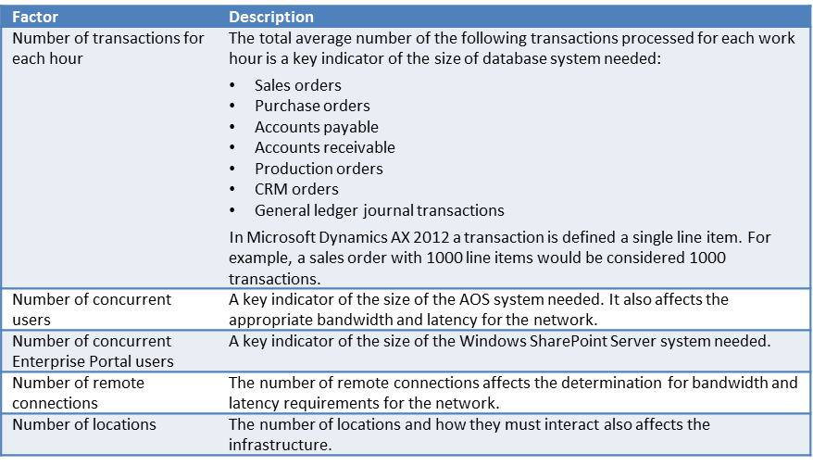
General Sizing Factors

Slide 41
Domain Requirements
Domain functional level of 2008 native or higher

Slide 42
Network Requirements
All of the server infrastructure should be in the same data center. High bandwidth and low latency is required.
Microsoft Dynamics AX clients should use Remote Desktop servers when there is more than 5 millisecond of latency between the client and AOS.
The Remote Desktop user experience is very good up to 150 millisecond of latency. Beyond that point, screen refresh rates can be noticeably slow.

Slide 43
Operating System Requirements
Component | Runs on a 32-bit operating system | Runs on a 64-bit operating system | Notes
AOS | Not recommended | Yes
Windows Client | Yes | Yes | Runs in 32-bit mode on 64-bit operating systems.
Office Add-Ins | Yes | Yes
Remote Desktop Services Integration | Yes | Yes
Enterprise Portal | No | Yes
Help Server | No | Yes
Reporting Services Extensions | Not recommended | Yes | The 32-bit version of SSRS can be installed on a 64-bit operating system. However, the Microsoft Dynamics AX Reporting Services extensions are not supported in this scenario.

Slide 44
Operating System Requirements (continued)
Component | Runs on a 32-bit operating system | Runs on a 64-bit operating system | Notes
Synchronization Service | Yes | Yes
Synchronization Proxy | No | Yes
Web Services on IIS | Yes | Yes
.NET Business Connector | Yes | Yes | Both the 32-bit and 64-bit versions of the .NET Business Connector are installed when you are using a 64-bit operating system.
Debugger | Yes | Yes
Visual Studio Tools | Yes | Yes

Slide 45
SQL Server Disk Recommendations
Redundant array of independent disks (RAID) for fault tolerance.
RAID 10 provides the best performance, but many different configurations can work well if they provide the necessary Input/Output Operations Per Second (IOPS).
Disk sec/Read and Disk sec/Write at 10 milliseconds, and below, indicate good response times.

Slide 46
Typical Hardware
There are many factors that need to be considered to size hardware appropriately.
Consider how each component scales when sizing hardware.
Some samples are provided on the following slides.
These are samples only.
Do not use these samples to size an actual implementation.

Slide 47
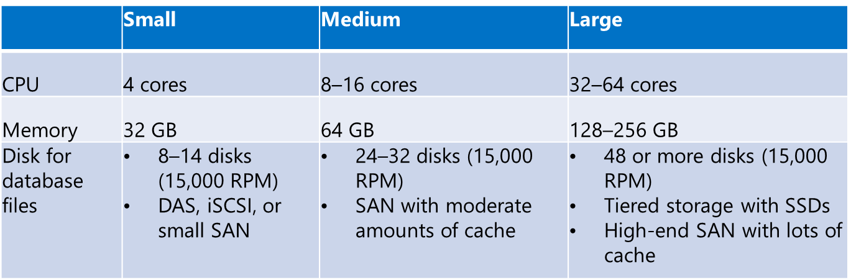
Typical Hardware: SQL Server
SQL Server only scales up, so it is the most important server to size correctly.
Transaction volume is the biggest factor.
Number of users is not necessarily a factor.
Most customers do not virtualize this component.

Slide 48
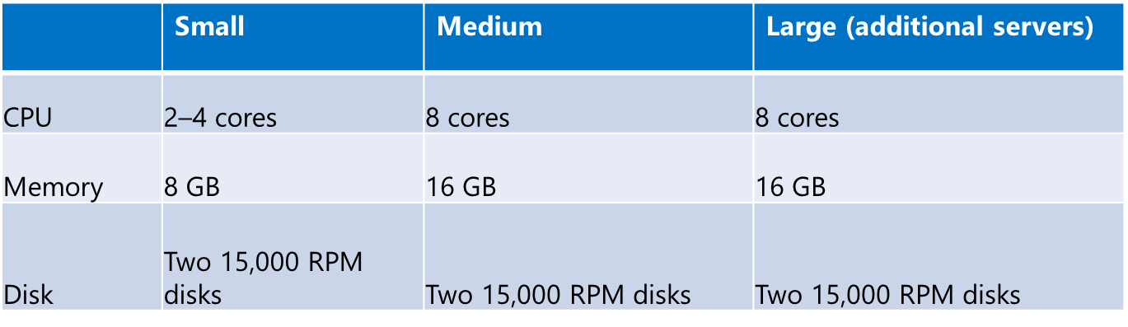
Typical Hardware: AOS
AOS servers scale up or out.
Most customers choose to scale out by adding servers instead of making the servers more powerful.
Transaction volume is the greatest factor.
Number of users is important, but a secondary factor.
Physical and virtual server deployments are common.

Slide 49
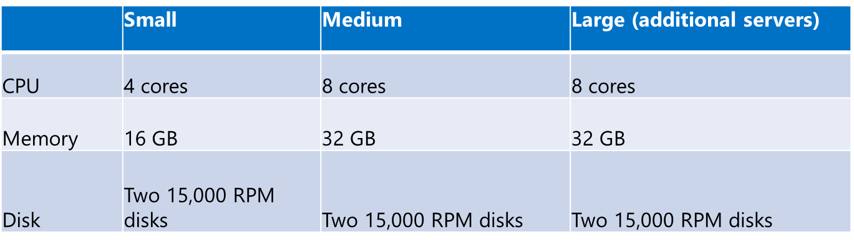
Typical Hardware: Enterprise Portal Server
Enterprise Portal servers scale up or out.
Most customers choose to scale out by adding servers instead of making the servers more powerful.
Concurrent users can be a good indicator.
Physical and virtual server deployments are common.

Slide 50
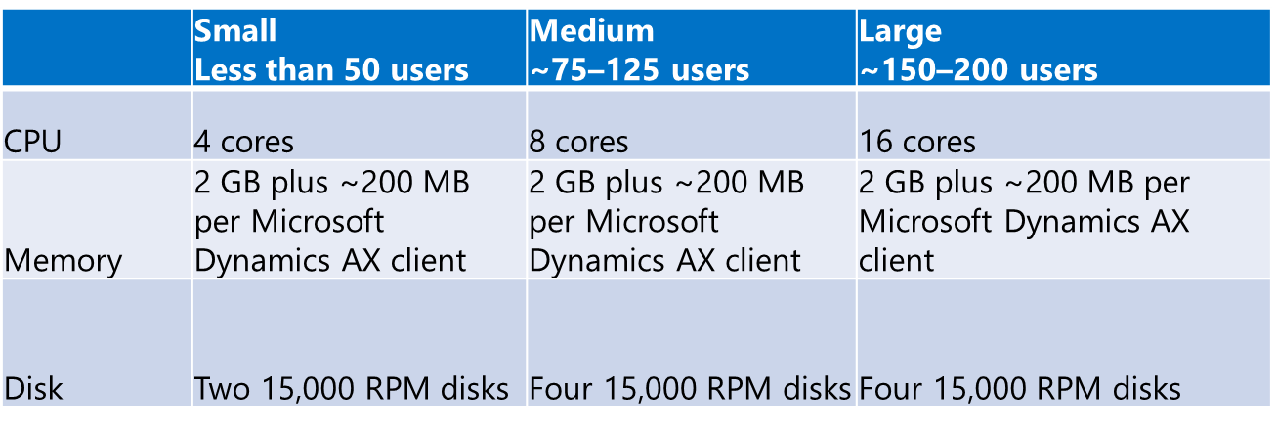
Typical Hardware Remote Desktop Server
Remote Desktop servers scale up or out.
Concurrent users can be a good indicator.
Transaction rate per user is also very important.
Physical and virtual server deployments are common.

Slide 51
Disaster Recovery
Overview
Planning disaster recovery
Disaster readiness
Notes:
All companies should have a thorough disaster recovery plan that describes what the company will do if a disaster happens.
To determine what provisions to make for partial or complete loss of data, stakeholders must determine the total cost of rebuilding or replacing the organization's data. Consider the following:
What are the costs of reconstructing the organization's financial, personnel, and other business data?
What does the business insurance cover with regard to replacing lost data?
How long would it take to reconstruct the business’ data? How would this translate into lost future business?
What is the cost for each hour of server downtime?

Slide 52
Disaster Recovery Overview
Determine recovery requirements. Hot site, cold site, or just protect the data.
Document server build process.
Have all installation media, license keys, and customizations available.
Know your integrations and how they will be recovered.
Notes:
Planning Disaster Recovery
A disaster recovery plan is necessary to ensure that all systems and data can be quickly restored if a disaster occurs. It is important to determine and prepare for all the steps required to respond to each type of disaster, and to test the recovery steps by simulating a catastrophic event.
A disaster recovery plan can be structured in many different ways and contain many types of information, such as the following:
Information about who owns the administration of the plan
A list of people to contact and instructions on how to contact them
A list of potential disasters and a checklist for recovery from each disaster scenario
Procedure for performing backups
Off-site storage policies
Procedures for restoring servers and the network
A plan to obtain hardware, if necessary
How long recovery should take and the final database state the users can expect
Steps for reviewing the documentation whenever changes are made to the computers or network

Slide 53
Disaster Recovery Planning
Database
Protect all databases for the solution
Microsoft Dynamics AX database(s)
SharePoint databases
Reporting Services and Analysis Services databases
Integration databases
Use the FULL recovery model
Database and transaction log backups for point-in-time recovery
Consider log shipping, mirroring, or AlwaysOn to automatically move your data offsite
Identify places where server names, URLs, and so on are stored in the database so you can modify them upon recovery in a new environment

Slide 54
Disaster Recovery Planning
AOS
Document AOS configurations
By default, no data is stored on the AOS server
Report Server
Store all reports in the AOT so they can be redeployed at any time

Slide 55
Disaster Recovery Planning
Enterprise Portal (EP)
Use standard SharePoint backup and recovery procedures
Store all customizations in the AOT so they can be redeployed at any time
Client
Document client configurations
By default, no data is stored on the client

Slide 56
Disaster Readiness
Practice documented recovery procedures regularly
Update documentation when changes are made to the environment
Notes:
Disaster Readiness
Perform the following activities to ensure the business is ready for a disaster:
Perform regular backups of the system and user databases, the transaction log, and the Microsoft Dynamics AX application files to reduce data loss. How frequently a company performs backups depends on how much information they can afford to lose compared to the overhead of performing backups too frequently.
Thoroughly test backup and recovery procedures on a regularly scheduled basis.
Testing ensures the backups are restorable and the recovery procedures are clearly defined and documented
Document the following:
Database and file user rights
Product keys for all software
Service packs installed on Windows, the database, and Microsoft Dynamics AX
Recovery of other databases, such as SharePoint Services Foundation

Slide 57
Naming Convention: Examples
Install Type | Base Role | Naming Convention Examples
Live Environment | Database Name AOS Name Client Name | CON_AX2012_DB_Live CON_AX2012_AOS_Live CON_AX2012_Client_Live
Test Environment | Database Name AOS Name Client Name | CON_AX2012_DB_Test CON_AX2012_AOS_Test CON_AX2012_Client_Test
Development Environment | Database Name AOS Name Client Name | CON_AX2012_DB_Dev CON_AX2012_AOS_Dev CON_AX2012_Client_Dev
Notes:
Because multiple applications are possible, the naming convention is important. The recommendation is to use a name that clearly identifies the customer, version, and type of installation.
This name should include a short form of the customer name, the Microsoft Dynamics AX 2012 version, the service pack version, and a code for the installation type, such as Live, Test, or Dev.
Example
The CON_AX2012_Live name signifies that this is a live, or production, installation of Microsoft Dynamics AX 2012, without any service packs, for the Contoso, Ltd. customer.
If the administrator wanted to track service packs, the name could be changed to CON_AX2012_SPxx_Live. where xx would be replaced with the version of the service pack installed.
One reason for having a clear naming convention is that the Microsoft Dynamics AX client, or the AOS configuration, links the application object with the database. If the names are unclear, it is easy to accidentally set up a client to use development application objects and connect to a production database, which could result in lost or corrupted data.

Slide 58
Test Your Knowledge:
The class will complete this section

Slide 59
Chapter Review
Describe the use and purpose of using a RAID subsystem.
Clients can connect to the AOS by using which of the following methods? (Select all that apply.)
( ) Remote Procedure Calls (RPCs)
( ) Windows Communication Foundation (WCF)
( ) AOS services
( ) .NET Business Connector
True or False? All Microsoft Dynamics AX components are supported on a 64-bit operating system.
( ) True
( ) False

Slide 60
Chapter Review (continued)
Which of the following is not an element of the client?
( ) Rich user interface
( ) MorphX development environment
( ) Visual Studio development environment
( ) Reports
Which of the following components do not support 32-bit operating systems? (Select all that apply.)
( ) .NET Business Connector
( ) Enterprise Portal
( ) Visual Studio Tools
( ) Help Server

Slide 61
Chapter Review (Answers)
Describe the use and purpose of using a RAID subsystem.
RAID refers to a group of two or more disks managed as a single unit to store the data together with additional, or redundant, information to provide recovery if there is a disk failure.
Clients can connect to the AOS by using which of the following methods? (Select all that apply.)
(X) Remote Procedure Calls (RPCs)
(X) Windows Communication Foundation (WCF)
( ) AOS services
( ) .NET Business Connector
True or False? All Microsoft Dynamics AX components are supported on a 64-bit operating system.
(X) True
( ) False

Slide 62
Chapter Review (Answers) (continued)
Which of the following is not an element of the client?
( ) Rich user interface
( ) MorphX development environment
(X) Visual Studio development environment
(X) Reports
Which of the following components do not support 32-bit operating systems? (Select all that apply.)
( ) .NET Business Connector
(X) Enterprise Portal
( ) Visual Studio Tools
(X) Help Server

Slide 63
Chapter Summary
This chapter provided an overview of Microsoft Dynamics AX 2012:
System Architecture
Development System and Tools
Planning a Deployment: Hardware and Software
Disaster Recovery

